Slide 1
Brave New World of Work - But Does the Digital Transformation of Work Promote Inclusion? Professor Dr Joachim Breuer President of the International Social Security Association (ISSA)
30 years of the State Fund for Rehabilitation of Disabled Persons
- past, present, future!
13 October 2021

Slide 2
@ standuppaddle - Pixabay

Slide 3
@ Leslie Holland

Slide 4
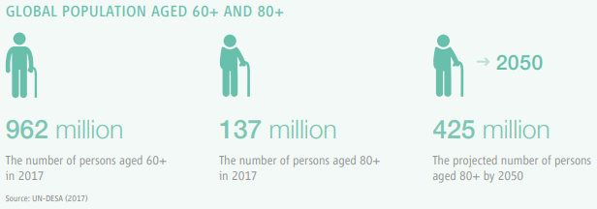
The global population is ageing (WHO)

Slide 5
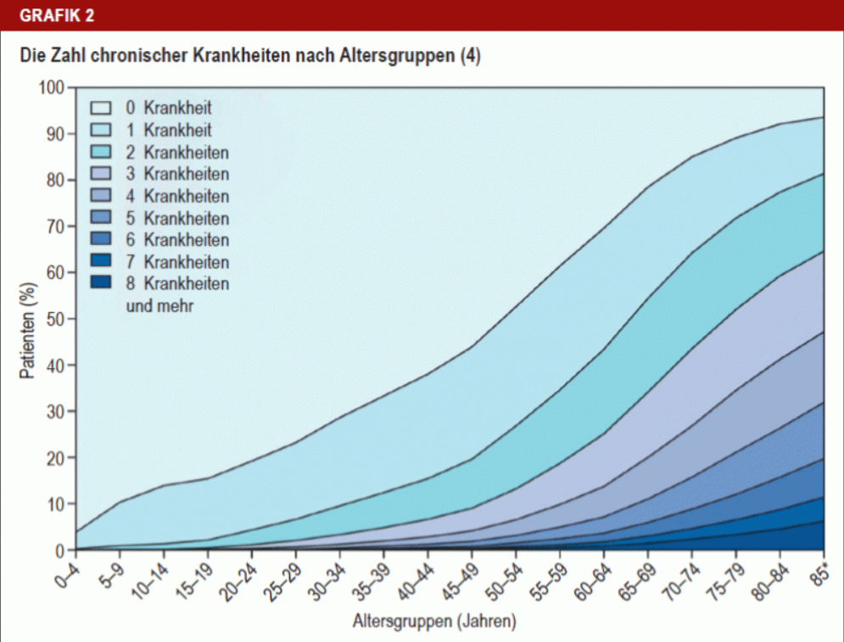
Number of chronic diseases by age group
Patients (%)
Age Group in years
Source: Deutsches Ärzteblatt 2020 ; 117(44): A-2092 / B-1780

Slide 6
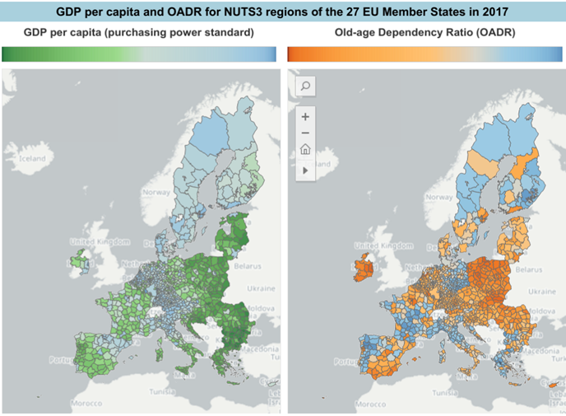
Source: European Atlas of Demography

Slide 7
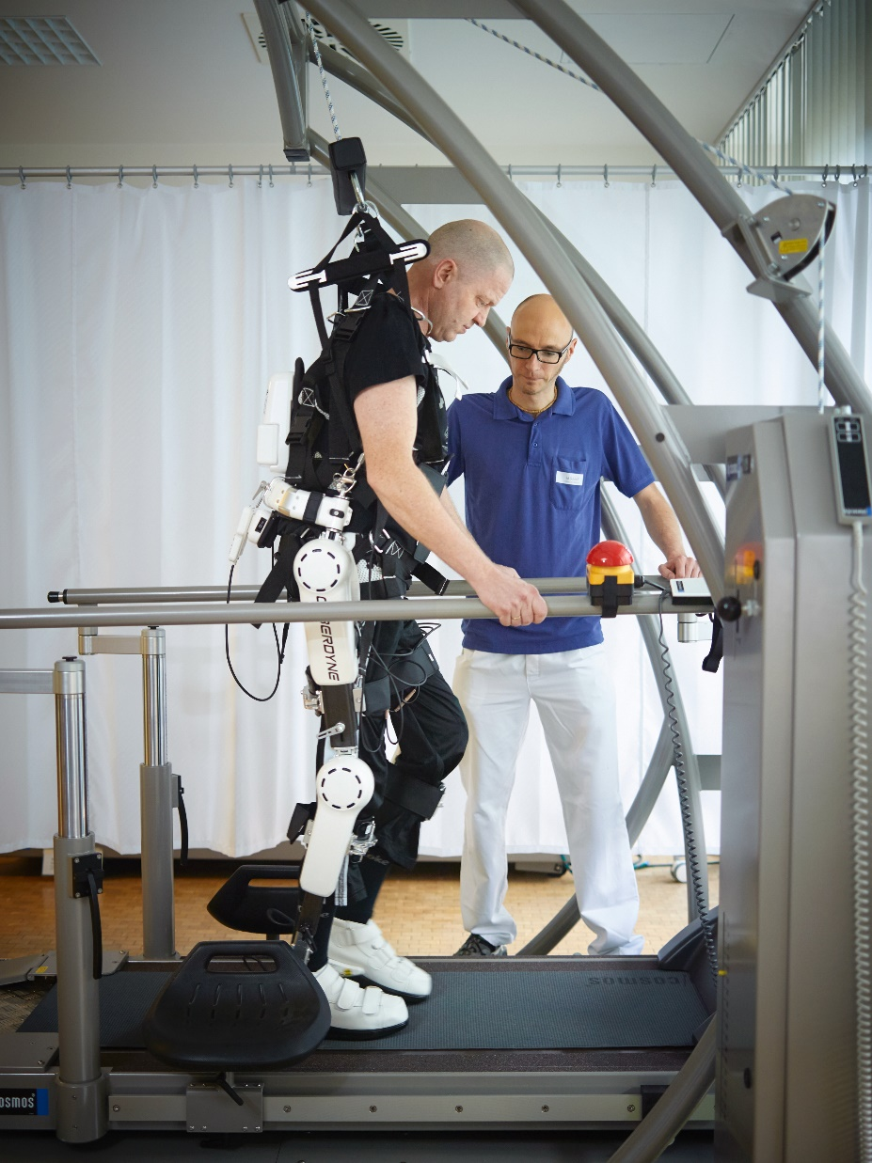
Exoskeleton
… and much more ... (to come) ...
@ ärzteblatt.de
@ Jan Pauls/ BG Klinikum Bergmannstrost Halle
@ neurosciencenews.com

Slide 8
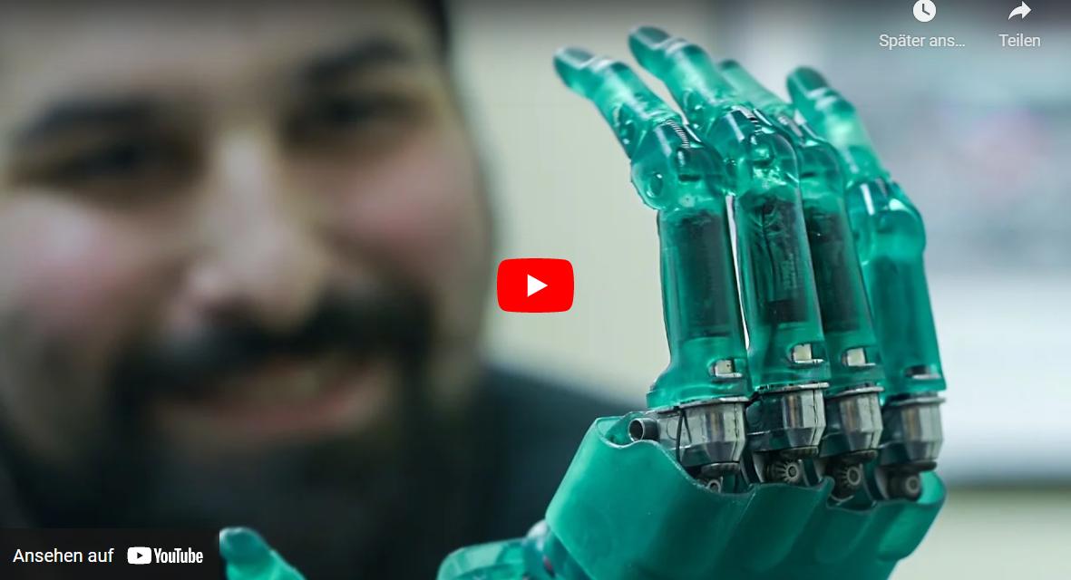
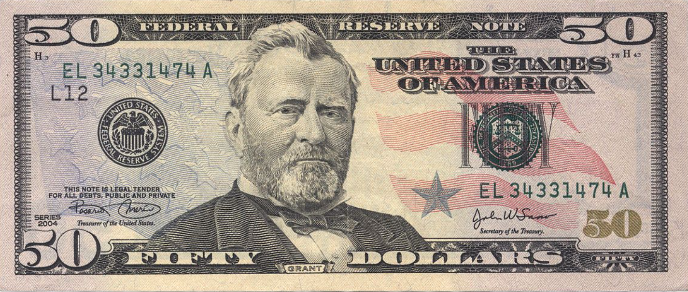
@ formlabs 6.3.2021

Slide 9
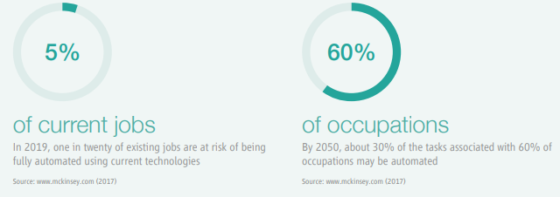
The digital economy is changing the world of work

Slide 10
Thank you!

