Slide 1
The extraordinary challenges addressing access for persons with multiple disabilities in developing countries
Arun Mehta
arun.mehta@gmail.com
skid.org.in, bapsi.org

Slide 2
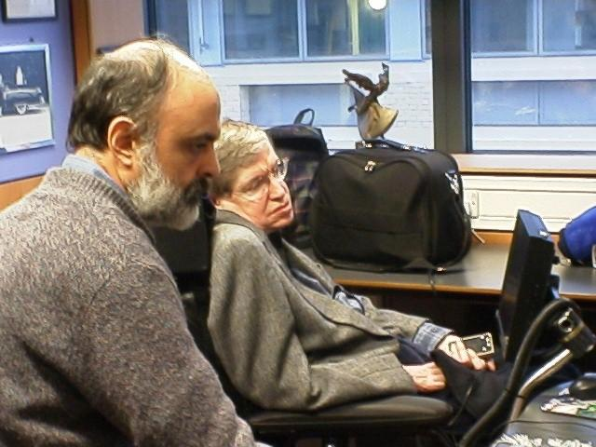
Professor Stephen Hawking could only press one button....

Slide 3
“I am quite often asked: How do you feel about having ALS. The answer is, not a lot. I try to lead as normal a life as possible, and not think about my condition, or regret the things it prevents me from doing, which are not that many.”
-Prof. Stephen Hawking
http://www.hawking.org.uk/text/disable/disable.html

Slide 4
But what about developing countries?
Prof. Hawking had the support of the NHS, Cambridge University and a thriving tech ecosystem, and money
A severely disabled person in an affluent country spends around US$ 25000 annually on finding out what technology to procure, then obtaining it, getting trained in its use, and keeping it repaired
In a developing country, even if you don’t start out poor, a severely disabled family member often makes you poor
Support from government is negligible, when it comes to access technology

Slide 5
Problems relating to access technologies
the variety of disabilities, their combinations and varying severities indicate that we need different software for each child
also, the software must grow with the child, and be able to handle multiple languages: It must enable all the things people do with computers
How do you find people to create this tech?
How to handle the next version of hw and sw?

Slide 6
Why Web Programming?
The user doesn't need to install software on her machine: it is installed at one place, and users share it without mutual interference
Easy to track actual usage, learning patterns,...
Front end is a regular web browser, which even runs on mobile phones, and is highly accessible, multilingual, familiar
Future proof(?)

Slide 7
Front End: Android phones and tablets
Inexpensive
Familiar
Variety of form factors
Easy to program (e.g. MIT App Inventor, using drag and drop visual programming)
Easy to distribute and to manage upgrades

Slide 8
Problems we have faced
Funding: “If this is such a good idea, how come they aren’t already doing it in the US?”
Lack of programmers: once, we were a British colony. Our masters took our cotton, turned it into cloth, and sold it back to us. Now, our software developers mostly work for multinationals, which package the software that they write, and sell it back to us
Our access to free software writing was, essentially, computer science students doing summer training with us
Things are improving

Slide 9
Software by and for the disabled
Some of the best software for blind people was written by the blind. For instance, Chris Hofstader worked at Freedom Scientific on the screen reader JAWS. He says "The greatest thing for me was the freedom to invent my future. I was building technology that the next day I could use myself."
T.V. Raman, who wrote emacspeak, is a great role model.
James Teh and Michael Curran, both blind students, developed open-source screen reader program, NVDA (Non Visual Desktop Access).

Slide 10
Long term solution
A training facility for students with different kinds of disability, where they learn how to create and repair access technologies
Given the furious pace at which technology changes, taking advantage of new technologies is essential. The potential users need the confidence that when necessary, the products will also be repaired and upgraded inexpensively
It would be an honour to support such a facility in Poland

