Slide 1
PARTICIPATION IN WORKING LIFE – from an international PERSPECTIVE
Jan A. Monsbakken
Immediate Past president – RI global

Slide 2
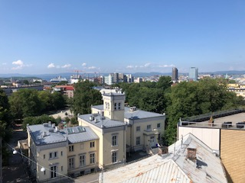
Oslo, Norway

Slide 3


Rehabilitation
International
Advancing the Rights and Inclusion of Persons with Disabilities World Wide

Slide 4
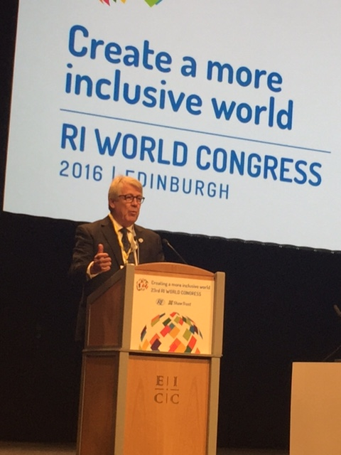
World Congress In Edinburgh -2016

Slide 5
Definition of working life , employment and self employment
«The part of a person’s life when they do a job or are at work.»
Employment . « The fact of someone being paid to work for a company or organization»
Self employment «is a situation in which an individual works for himself insted of working for an employer that pays a salary»

Slide 6
Unemployment – a global challenge
Difficult to find good statistics since differnt countries use different criterias when they make statistic’s on this issue.
But marginalized groups have greater difficulties to enter into the workforce
Among these marginalized groups we find PwDs, indigenous peoples, refugees, imigrants and others

Slide 7
How to enter the working life
Employment in the «normal» workforce
Self employment
Supported employment ( Individual Placement and Support ( IPS))- US and Canada in the 80th´s
Sheltered workshops

Slide 8
Work and employment ( pWds )
In Scandinavia – about 45-50 % of PwD are in the workforce
In Asia – about 10- 20% of PwD are working
Lack of inclusive education
Lack of Universal Design – lack of accessible transport- and workplaces
To much focus on Disability instead of Ability
Quotas in some countries

Slide 9
Quotas – Pros and contras
Research from several European countries carried out by dr. Birgitte von Lierop from Holland shows that quotas can be effective:
But it is on the condition that the working agencies respect the employers need to get support in adaption of the working place and follow ups additional to financial compensation for indivdual lack of productivity by the employee.
The example from Netherlands ( set a political goal for the employers within a time limit – if not reached – the result is a quota system ( in place in public sector )
84 countries world wide has a quota system in their national legislation

Slide 10
The link between employment and health
Work and employment is the single most important factor to secure good health – WHY?
Gives income to the person and to the society
Gives the person a feeling of being a part of the society
Gives the person a feeling of contributing and strenghtens selfesteem
Gives the person the chance to use his/her potential/ abilities
Gives the person a chance to grow and develop.

Slide 11
The global situation in work and employment PwDs
In developing countries – 80-90% are unemployed
In the most developed countries the unempolyment rate is 50-70 %
In EU – PwDs are two to three times more likely to be unemployed than others
Latin America and the Caribbians - 80-90% are outisde the work force
Australia – about 2/3 were unemployed
Asia/Pasific – 80% or more are unemployed

Slide 12
WHY – do we have this situation
A need for better data to describe the actual situation
Attitudes in the societies at large
Lack of political will to make a change
Lack of Awareness
The charity model is still in place in most societies

Slide 13
WHO can make the change?
Civil Society must play a leading role !
Both on a national – regional and a global level.
RI -GRA and other CS organizations has to continue it`s work.
ISSA and ILO can play an important role in the future on the global level within this field.

Slide 14
Who can change this situation? - Cont
Professional organizations
Media
Global entities like UN – ILO - WHO – Unesco – Unicef
Regional entities like UNESCAP – EU and others

Slide 15
What are the GLOBAL instruments ?
The UN declaration on Human Rights- 1948
The UN CRPD – 2006
The World Report on Disability - 2011

Slide 16
Article 22 - HRC
Everyone, as a member of society, has the right to social security and is entitled to realization, through national effort and international co-operation and in accordance with the organization and resources of each State, of the economic, social and cultural rights indispensable for his dignity and the free development of his personality.

Slide 17
Article 25 - HRC
(1) Everyone has the right to a standard of living adequate for the health and well-being of himself and of his family, including food, clothing, housing and medical care and necessary social services, and the right to security in the event of unemployment, sickness, disability, widowhood, old age or other lack of livelihood in circumstances beyond his control.

Slide 18
Other relevant UN Conventions
“Convention on the Elimination of All Forms of Discrimination Against Women (CEDAW) – Established in 1979
Ratified by 189 states
CSW – in New York - March

Slide 19

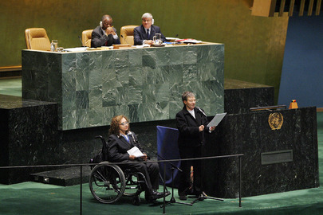
on Dec. 13, 2006 at the United Nations in New York.
Adoption of the UN CRPD

Slide 20
Convention of the Rights of Persons with Disability (CRPD), Art. 27 „Work and Employment“
„(1) States parties shall safeguard and promote the realization of the right to work, including for those who acquire a disability during the course of employment, by taking appropriate steps, including through legislation, to, inter alia:
(2) Promote vocational and professional rehabilitation, job retention and return to work programmes for persons with disabilities.

Slide 21
Articel 26 Habilitation and rehabilitation
“States Parties shall take effective and appropriate measures, including through peer support, to enable persons with disabilities to attain and maintain maximum independence, full physical, mental, social and vocational ability, and full inclusion and participation in all aspects of life.

Slide 22
Continue articel 26 – CRPD 2006
To that end, States Parties shall organize, strengthen and extend comprehensive habilitation and rehabilitation services and programms, particularly in the areas of health, employment, education and social services.”

Slide 23
World Report on Disability 2011
A cooperation between WHO and the World Bank
Published in 2011
RI Global was very active in the development of the report.

Slide 24
WHO Resolution on Disability
RI together with Equador promoted a new resolution in 2012.
Adopted by the WHA in May 2013.
The main focus of the resolution was to produce and adopt a Disability Action plan in WHA in 2014.

Slide 25

WHO global disability action plan 2014-2021:
Better health for all people with disability
DISABLING BARRIERS – BREAK TO INCLUDE

Slide 26
Objectives
To remove barriers and improve access to health services and programmes.
To strengthen and extend rehabilitation, habilitation, assistive technology, assistance and support services, and community-based rehabilitation.
To strengthen collection of relevant and internationally comparable data on disability, and support research on disability and related services.

Slide 27
WHO - Rehabilitation 2030 : A call for action

Slide 28

SDGs

Slide 29


Slide 30
Goal 3 - Health
“Ensure healthy lives and promote well-being for all at all ages”

Slide 31
Goal 8
By 2030, achieve full and productive employment and decent work for all men and women, including for young people and persons with disabilities, and equal pay for work of equal value

Slide 32
Goal 10
10.2. By 2030 empower and and promote social,economic and political inclusion of all, irrespective of age, sex, disability, race,origin,religion oreconomic or other status

Slide 33
How to make a change ?
Awareness raising
Better data collection
Change from charity to a rights based approach on Disability
Change politics and policies
Change attitudes in the society and among employers

Slide 34
Conclusions
A need for better data to describe the actual situation
Attitudes in the societies at large must be changed from disability to ability
Create a political will to make a change – Inclusion is an investment for the society and the individual
Increase Awareness – Use traditional media and social media
Change from a charity model to a rights based model

Slide 35
Conclusions - cont
Use the global instruments on national level
If all national governments are able to implement the global instruments on the gras rout level PwDs will particiapte in the workforce in line with all others by 2030.
Tis is a commen responsibility for Governments – Civil Society organizations DPOs and other stakeholders.

Slide 36
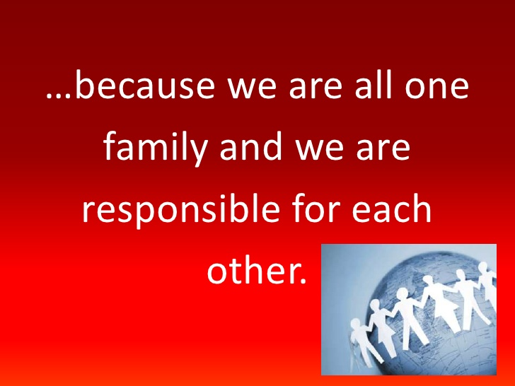
Inclusive working life

